Slide 1
The Best Foodie Neighborhood
in Pittsburgh
By: Pier, Aziz, Rachel

Slide 2
Methodology
Defining the "Foodie" Metric
01
Number of Restaurants
02
Restaurant Diversity
03
Farmers market and food gardens
04
Combined Score
Confidential

Slide 3
Measuring Foodie-Friendliness Through Restaurant Density
What we're measuring: Restaurants per square mile
Why density: Foodies care about walkable variety, not residential service. Density rewards walkable destinations like the Strip District, where few people live but many great restaurants are packed together.
Data source: Allegheny County Restaurant/Food Facility Inspection Violations dataset (WPRDC)
What we kept: Restaurants, bakeries, bars, supermarkets, and food processors
What we filtered out: School cafeterias, hospital kitchens, nursing homes, convenience stores, institutional and pre-packaged food facilities, and any establishment with a recorded close date.
How we computed it: Spatially joined each active restaurant's coordinates to Pittsburgh's neighborhood map, counted by neighborhood, divided by area in square miles, then normalized to a 0-100 score

Slide 4
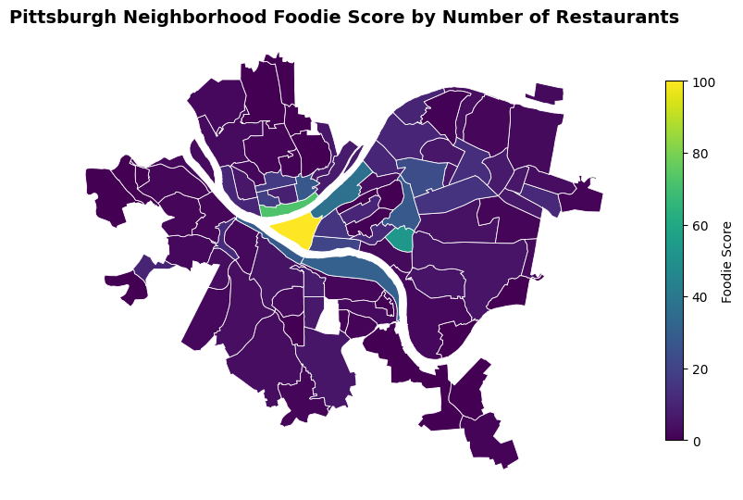
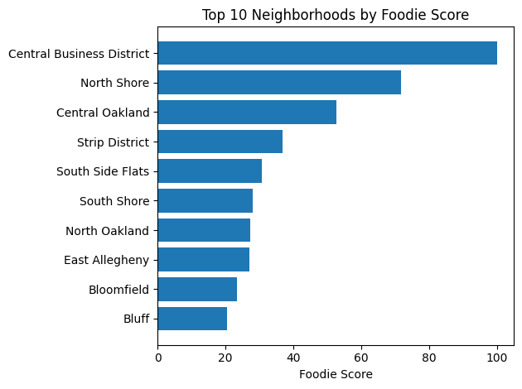

Results — Foodie Score Across Pittsburgh
Score = restaurants per square mile, normalized 0-100

Slide 5
Measuring Foodie-Friendliness Through Restaurant Diversity
What we're measuring: Diversity of food facilities per neighborhood
Why diversity: Foodies value not only number of restaurants available, but the diversity of restaurants as well. The best foodie neighborhood will have a good mix of restaurants, chains, food trucks, and more.
Data source: Allegheny County Geocoded Food Facilities (WPRDC)
What we kept: Active restaurants, bakeries, bars, supermarkets, and convenience stores.
What we filtered out: School cafeterias, hospital kitchens, nursing homes, and any inactive facility.

Slide 6

How We Computed Diversity
Each facility was given a weight based on its appeal to a foodie: 1.25 for non-chain restaurants, 1 for restaurants, 0.75 for supermarkets/bar/food trucks, and 0.5 for convenience stores.
Weights were summed per neighborhood and weighted proportion was calculated (facility type total weight / neighborhood total weight)
Shannon Index applied
Normalized to 0-100
Filtered to neighborhoods with 25+ facilities

Slide 7
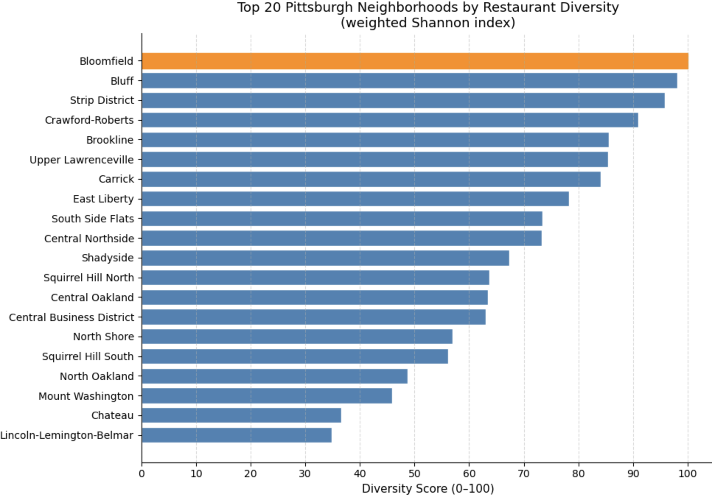
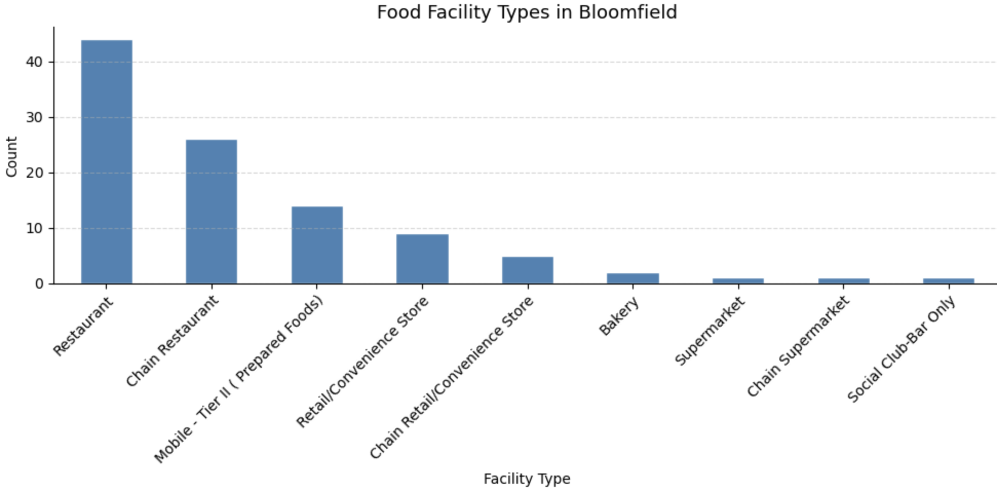
Results - Diversity
Scored based on the neighborhood with most diverse set of food facilities (filtered to neighborhoods with 25+)

Slide 8
Measuring Foodie-Friendliness Through Access to Farmers Markets and Stands
Why fresh food access: A true food culture isn't just about eating out, it's also about proximity to fresh, local ingredients. Farmers' markets and community gardens signal neighborhoods that invest in real food beyond restaurants.
What we're measuring: Farmers Markets per neighborhood.
Data source: Allegheny County Allegheny County Farmers Market Nutrition Program
https://data.wprdc.org/datastore/dump/0d99978a-ccf6-4315-af5a-a95acec87a9f
How we computed it: Spatially joined each active farmers market and farm stand coordinates to Pittsburgh's neighborhood map. From there we counted total locations per neighborhood to provide an accurate reflection of urban food resource distribution. The neighborhood with the most locations being the best.

Slide 9
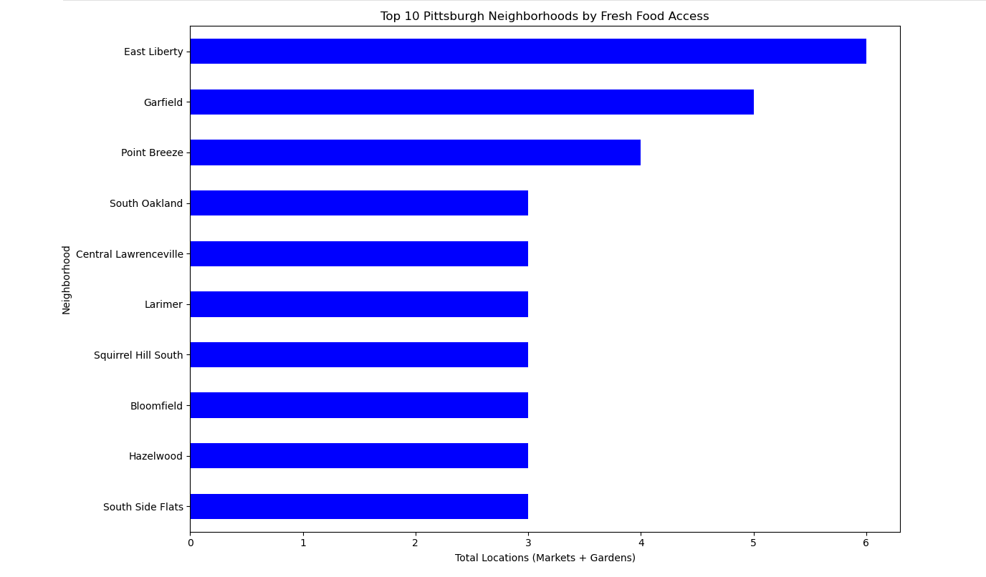
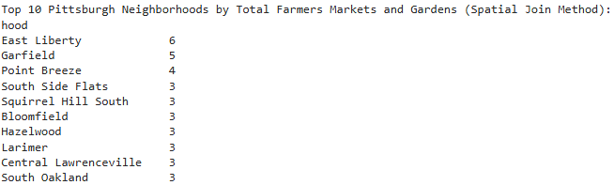
Results - Fresh Food Access
Scored based on the amount of locations per neighborhood. (Most locations = best)

Slide 10
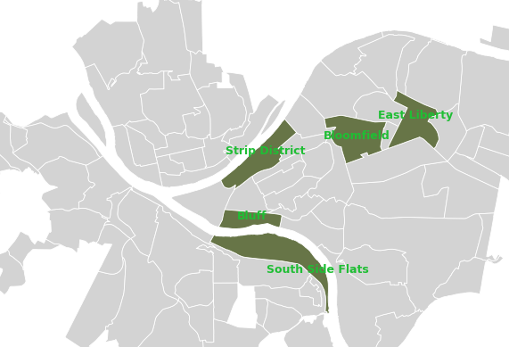
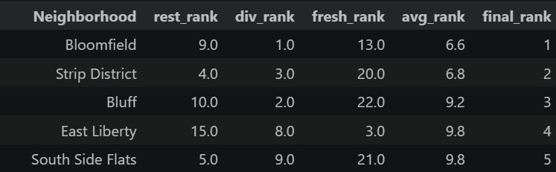
Conclusion
Combined Metric: We ranked each neighborhood within all three metrics (restaurant density, diversity, and fresh food access), then computed a weighted average rank with restaurants and diversity each weighted at 40% and fresh food access at 20%. The neighborhood with the lowest average rank is the most foodie-friendly.

Slide 11
Thank you!
Confidential

